Slide 1
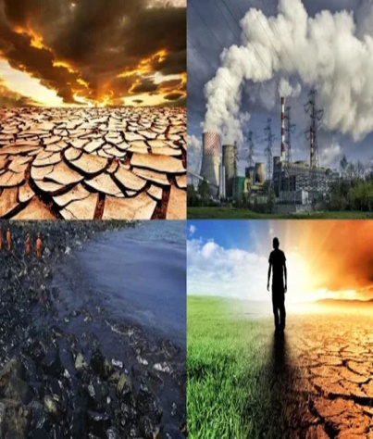
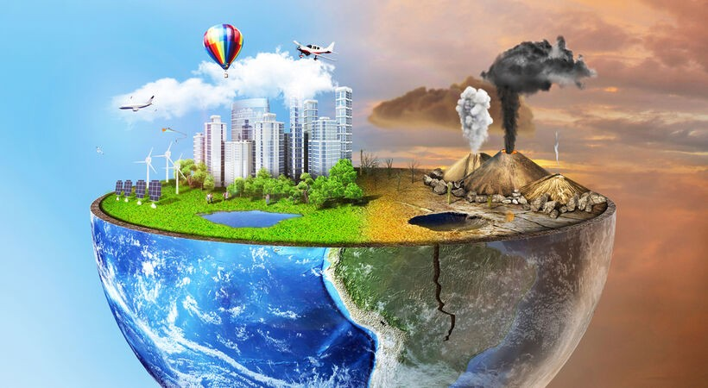
POLLUTION
WATER Pollution
SOIL POLLUTION
THERMAL POLLUTION
VISUAL POLLUTION
LIGHT POLLUTION
NOISE POLLUTION
AIR pollution

Slide 2
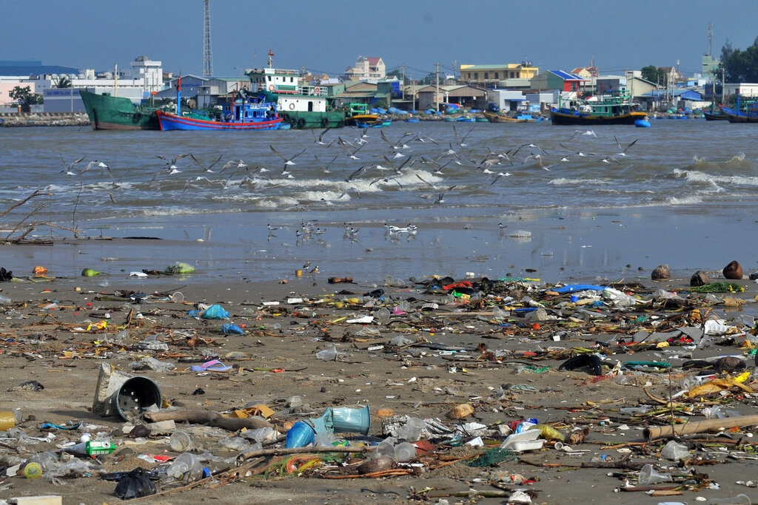
WATER POLLUTION
Pollution can cause water to become toxic to humans, which can lead to infections and health problems. Water is an essential resource for all life on Earth. If a water source becomes contaminated due to pollution, it can lead to health issues in humans, such as cancer or cardiovascular conditions.

Slide 3

SOIL POLLUTION
Soil pollution refers to the contamination of soil with anomalous concentrations of toxic substances. It is a serious environmental concern since it harbors many health hazards. For example, exposure to soil containing high concentrations of benzene increases the risk of contracting leukemia.

Slide 4
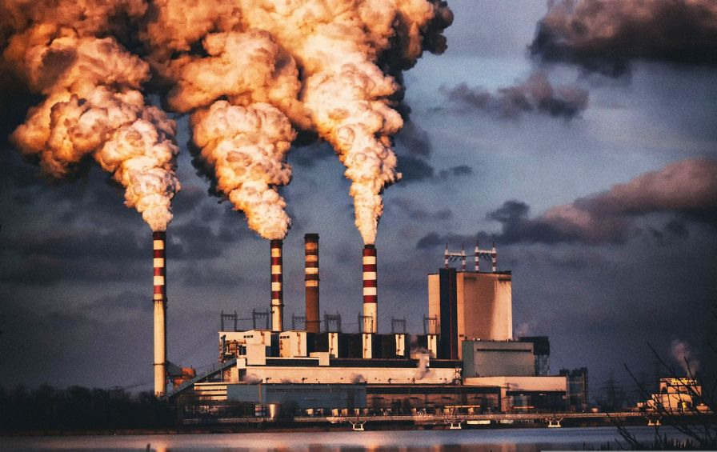
THERMAL POLLUTION
Heated water from the industries can treated before discharging directly to the water bodies.
Heated water from the industries can be treated by the installation of cooling ponds and cooling towers.
Industrial treated water can be recycled for domestic use or industrial heating.

Slide 5

VISUAL POLLUTION
One of the simplest ways to reduce visual pollution is to use natural materials, such as wood, stone, or bamboo, in your structures. These materials can blend well with the surrounding landscape, create a sense of warmth and harmony, and reduce the contrast between artificial and natural elements.

Slide 6

LIGHT POLLUTION
Light pollution, or artificial light at night, is the excessive or poor use of artificial outdoor light, and it disrupts the natural patterns of wildlife, contributes to the increase in carbon dioxide (CO2) in the atmosphere, disrupts human sleep, and obscures the stars in the night sky.

Slide 7

NOISE POLLUTION
Noise pollution adversely affects the lives of millions of people. Studies have shown that there are direct links between noise and health. Problems related to noise include stress related illnesses, high blood pressure, speech interference, hearing loss, sleep disruption, and lost productivity

Slide 8
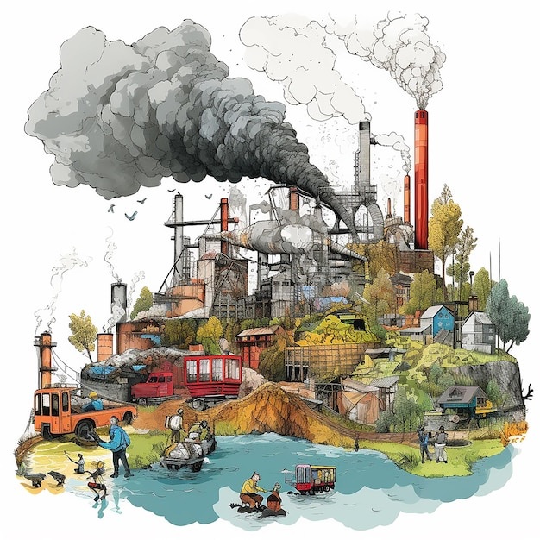
AIR POLLUTION
Long-term health effects from air pollution include heart disease, lung cancer, and respiratory diseases such as emphysema. Air pollution can also cause long-term damage to people's nerves, brain, kidneys, liver, and other organs. Some scientists suspect air pollutants cause birth defects.

